Slide 1
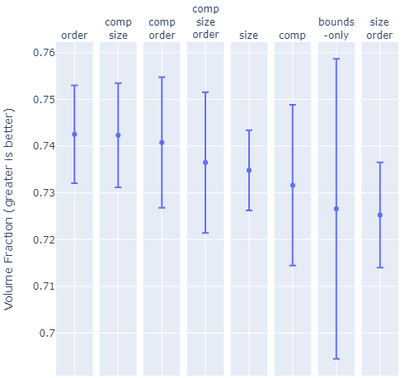
Num. Constraints | 2 | 2 | 3 | 3 | 1 | 1 | 0 | 2

Slide 2
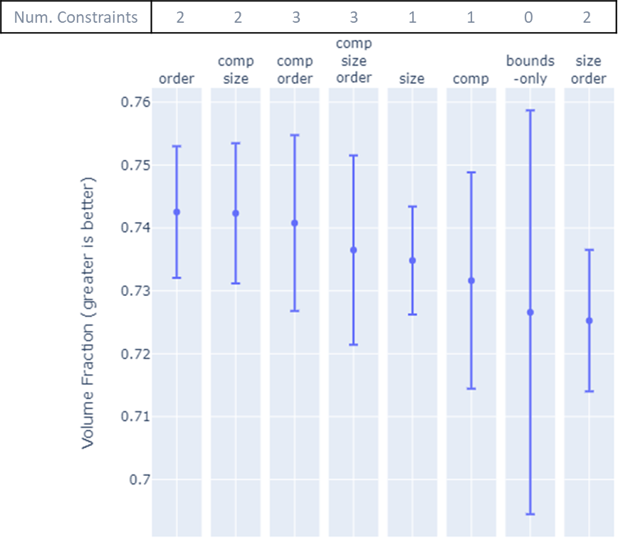

Slide 3


Slide 4


Slide 5
Maximize Packing Fraction via Constrained Bayesian Optimization
Original
Invariant
Size
Composition
Permutation

Slide 6
